Slide 1
32-bit x86 Assembly Language
Marius Vanța
mvanta@bitdefender.com

Slide 2
Agenda
Data representation
32-bit x86 CPU architecture
Memory addressing
Operand addressing modes
Instruction set
Control flow
Assembly language

Slide 3
1. Data representation

Slide 4
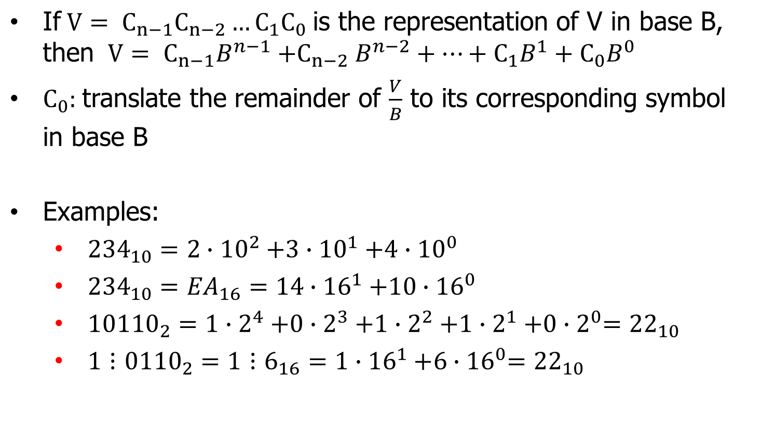
Numeral systems retrospect

Slide 5
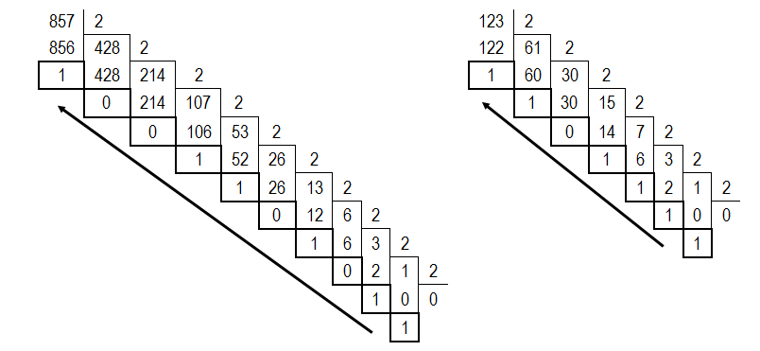
Numeral systems retrospect
Base 2 transformation examples:
857₍₁₀₎ = 1101011001₍₂₎ 123 ₍₁₀₎ = 1111011₍₂₎

Slide 6
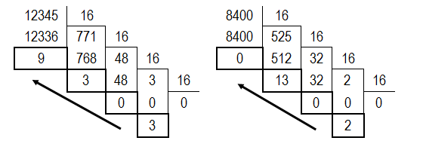
Numeral systems retrospect
Base 16 transformation examples:
12345₍₁₀₎ = 3039₍₁₆₎ 8400₍₁₀₎ = 20D0₍₁₆₎

Slide 7
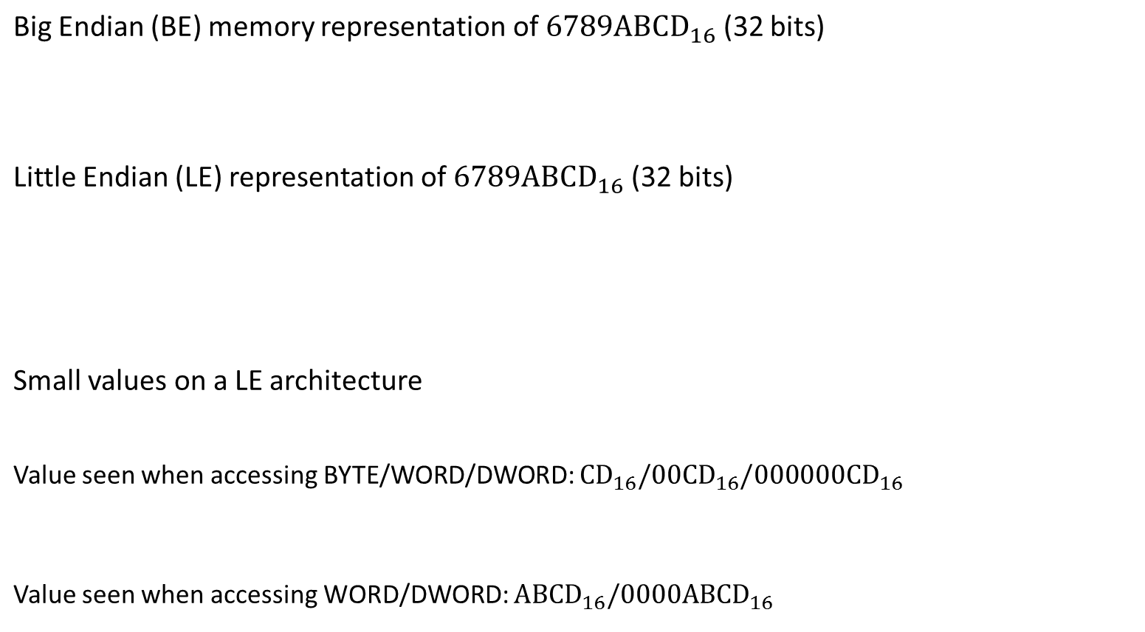
Endianess
31 30 29 28 27 26 25 24 | 23 22 21 20 19 18 17 16 | 15 14 13 12 11 10 09 08 | 07 06 05 04 03 02 01 00
67 | 89 | AB | CD
07 06 05 04 03 02 01 00 | 15 14 13 12 11 10 09 08 | 23 22 21 20 19 18 17 16 | 31 30 29 28 27 26 25 24
CD | AB | 89 | 67
CD | 00 | 00 | 00
CD | AB | 00 | 00

Slide 8
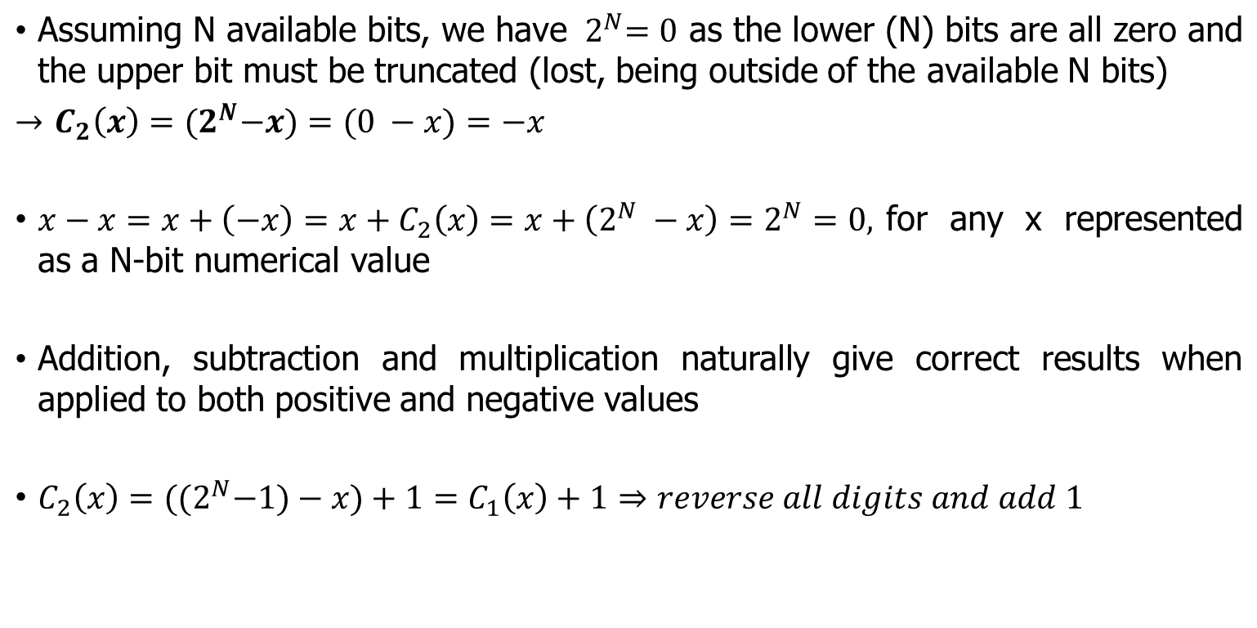
Two’s complement

Slide 9
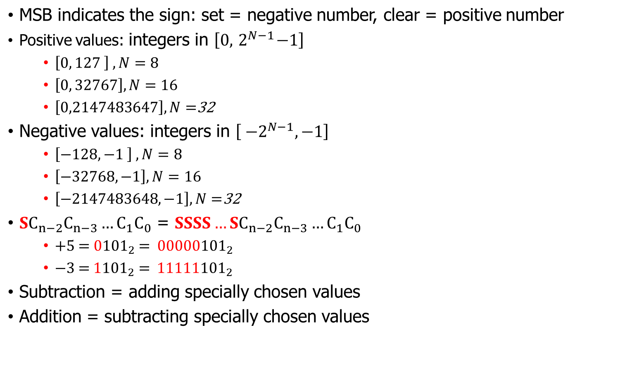
Two’s complement properties

Slide 10
2. CPU architecture

Slide 11
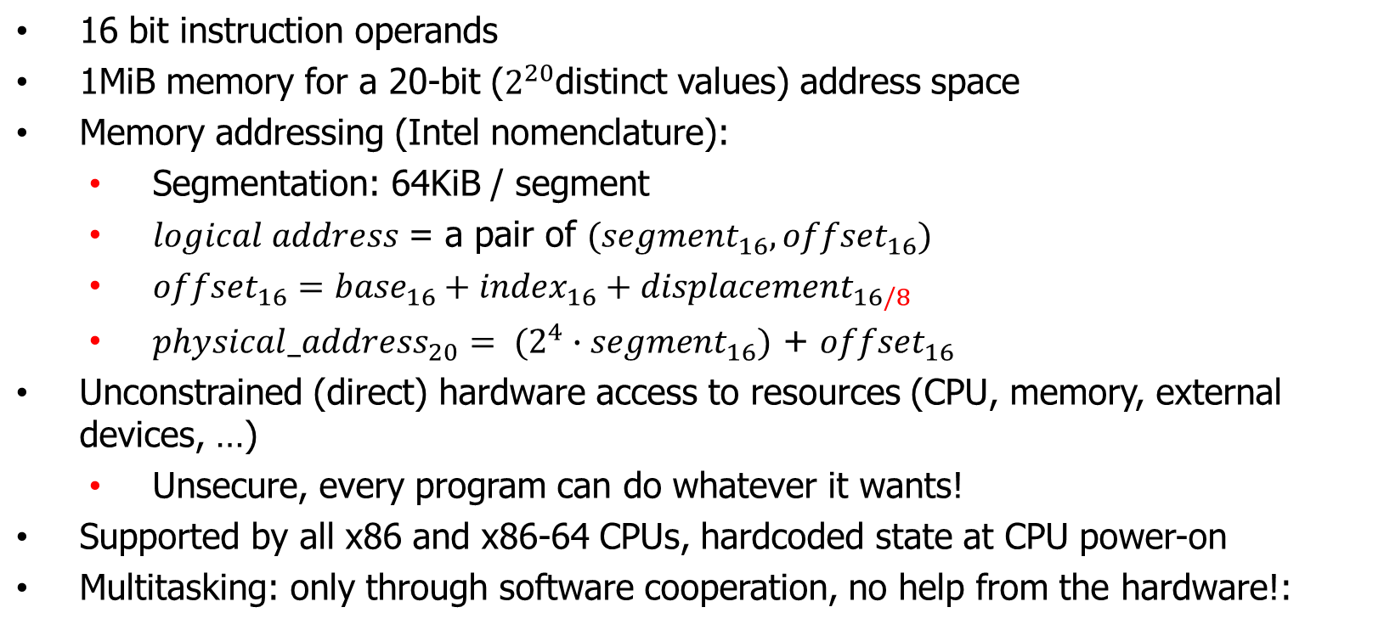
Real Mode Overview

Slide 12
Real Mode Overview
Limitations?
  Memory addressing
    Cumbersome to use
    One MiB of memory is clearly not enough
  No memory isolation for allowing multitasking
    OS vs programs: any program can overwrite OS data and code => unstable and insecure
    programs vs programs: any program can see and modify the memory of any other program
  Who is in control of the external devices?
    Everyone and no one!

Slide 13
Protected Mode Overview
Support for both 16 and 32 bits operand sizes and addresses
32-bit addresses => 4GiB addressable memory
Security and multitasking capabilities:
  4 privilege levels / rings: the CPU knows if the current instruction belongs to the OS (ring 0) or some more or less limited application (rings 1 up to 3 – least privileges)
  Privileged instructions: only the OS can execute instructions that have system-wide effects
    Example: CLI
  Virtual memory:
    each program is configured by the OS to have its own view of the memory, just like it would have a full 4GiB of addressable memory at its disposal
    the OS has full control over how the actual physical memory is being used
More configurable memory access control:
  An updated segmentation mechanism
  Memory paging

Slide 14
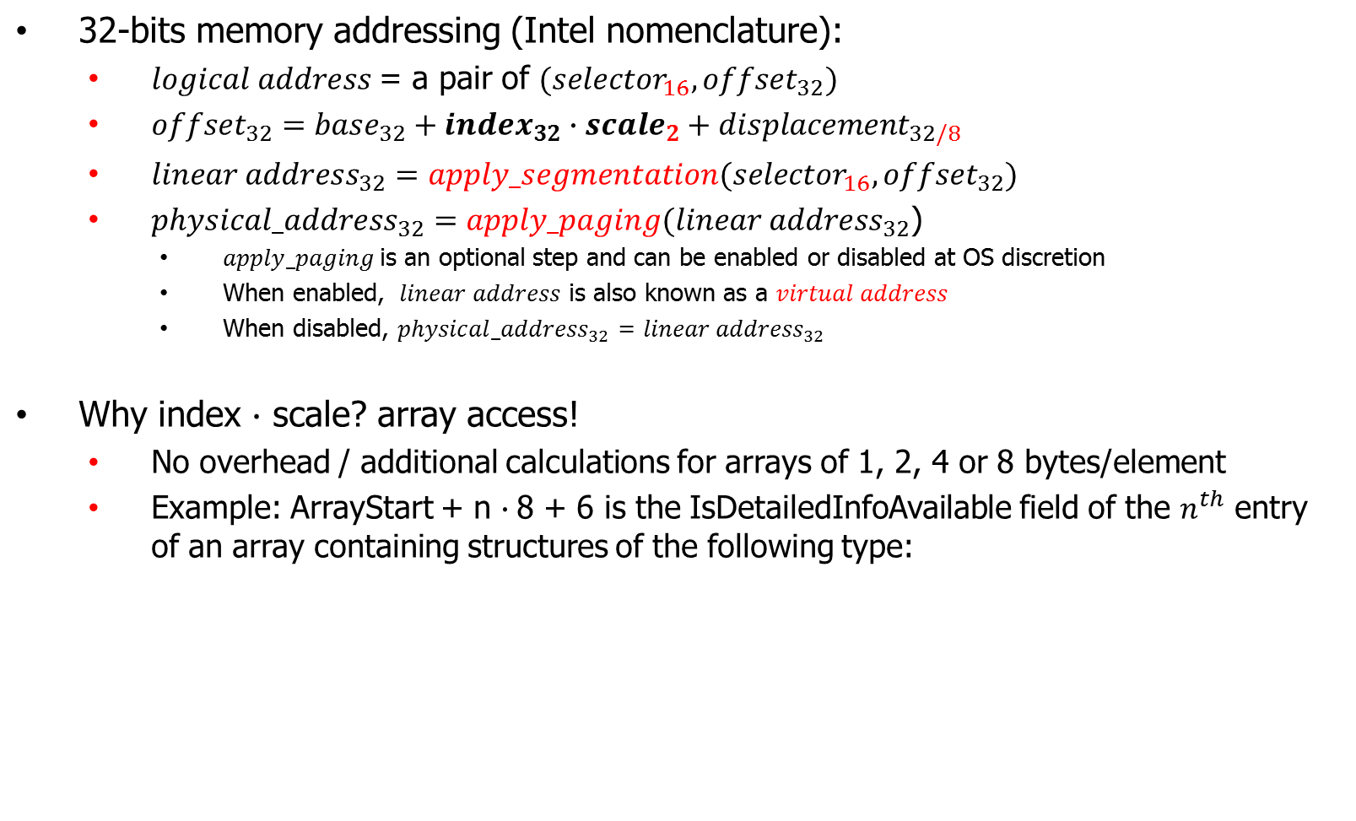
Protected Mode Overview
Field Name | Field type info
DetailedInfo | 32-bit pointer to additional data
SizeOfDetailedInfo | 16-bit integer
IsDetailedInfoAvailable | 8-bit boolean value
_AlignmentByte | 8-bit dummy field / padding

Slide 15
Protected Mode - Segmentation
Improved version of the 16-bits segmentation mechanism
Conceptually, segmentation is a function implemented as a lookup table:
  apply_segmentation: logical address space → linear address space
  The lookup table, called a descriptor table, is an array of segment descriptors describing the segments known/available to the program
  The data structures are preconfigured by the OS before starting the program
A segment descriptor data structure contains:
  The start address and the size of the segment
  Type: code, data, …
  Required privilege for usage: user / supervizor
  …
The CS, DS, ES, SS, … registers are now known as segment selectors and their values are indexes inside a descriptor table!
  While the program is allowed to change the values of CS/DS/ES/SS, the currently used descriptor table and its content can only be modified by the OS!

Slide 16
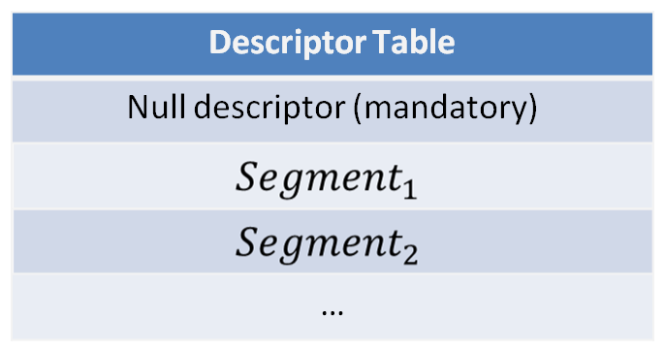
Protected Mode - Segmentation
Segmentation overview
Segment Selector
Segment start address
Offset
+
Linear Address

Slide 17
Protected Mode - Paging
A function that remaps the logical addresses of an application to the physical addresses allocated by the OS
  apply_paging: linear address space → physical address space
  This is the key hardware feature for providing virtual memory support!
Implemented as a (usually multi-level) lookup table preconfigured by the OS
  The linear/virtual address space is divided into chunks of fixed size known as a memory page
  A lookup table data entry corresponds to a whole page of virtual memory (the data structures do not remap individual bytes but whole pages)
  Some virtual addresses / memory pages might not have associated table entries and are considered invalid
    Example: the very first page of virtual memory has usually no mappings and will trigger a NULL pointer exception on access
Each table entry defines:
  The address of the physical memory allocated by the OS for the input virtual address
  Access restrictions: is read and/or write allowed? accessible to User/Supervisor?
  Present and Accessed bits (used by the OS for implementing memory swapping)
  …
A program has no control over its paging-related data structures but OS has:
  Example: the OS automatically performs any necessary adjustments whenever an application allocates memory (it allocates memory, sets-up the structures and returns the virtual address)

Slide 18

Protected Mode – Segmentation+Paging
Overview
Segment Selector
Offset
apply_segmentation
Virtual Address
apply_paging
Physical Address

Slide 19
CPU Registers
  General purpose
    EAX, EBX, ECX, EDX
  Segment (selectors)
    CS, DS, ES, SS, FS, GS
      FS and GS have no architectural special meaning/role
      They are still 16-bits registers!
  Control (privileged-access only)
    CR0 – protection enable, paging enable, caching, etc…
    CR2 – PF linear address: the address of the last Page Fault exception
    CR3 – PDBR: start address of the paging-related data structures
    CR4
  Index/Pointer
    ESI, EDI, ESP, EBP, EIP
  Indicator
    EFLAGS
  …

Slide 20
Registers
  32/16/8 bit general purpose registers
EAX
 |  | AX
 |  | AH | AL
  32/16 bit Index and Pointer registers
EBP
 | BP
  Not all registers are addressable this way! there is no such thing as ECS for CS, ECR0 for CR0, or SH and SL for SI, …

Slide 21
3. Memory addressing

Slide 22
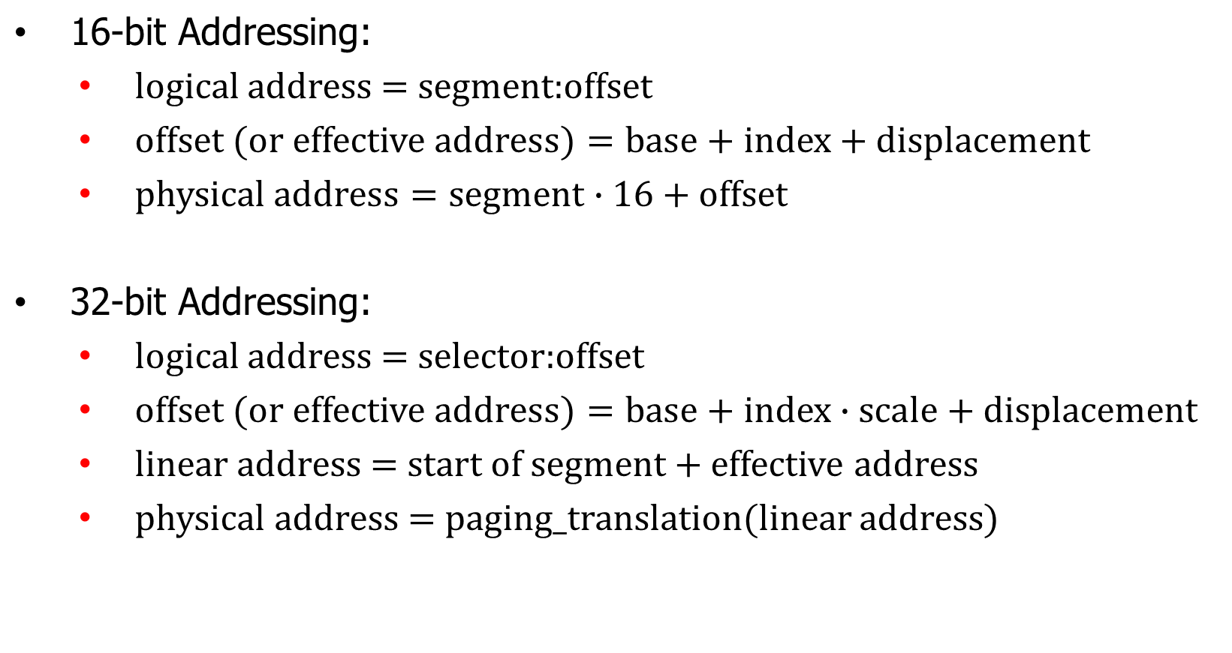
Memory addressing notions

Slide 23
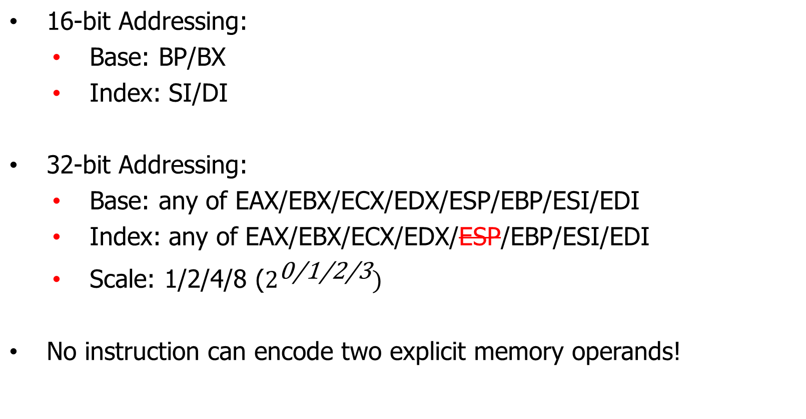
Memory addressing constraints

Slide 24
4. Operand Addressing modes

Slide 25
Addressing modes
Implicit or explicit
  Implicit: operands already chosen
    The operand is NOT encoded as part of the instruction bytes
    Exemples: cli, div, popf, stosd, …
  Explicit: choose the operands
Direct or indirect
  Direct: the value of the specified resource is the operand
  Indirect: the operand is located at the address pointed by the value of the specified resource
    Example: jmp [eax] -- encode eax as a numeric identifier but use it as a pointer to a memory location that contain the address of the code/instruction to jump to
Absolute or relative
  Absolute: the operand is at exactly the specified memory location (effective address)
  Relative: indicates some memory location at N bytes ahead or behind
    Addressing still works after copying the whole program somewhere else

Slide 26
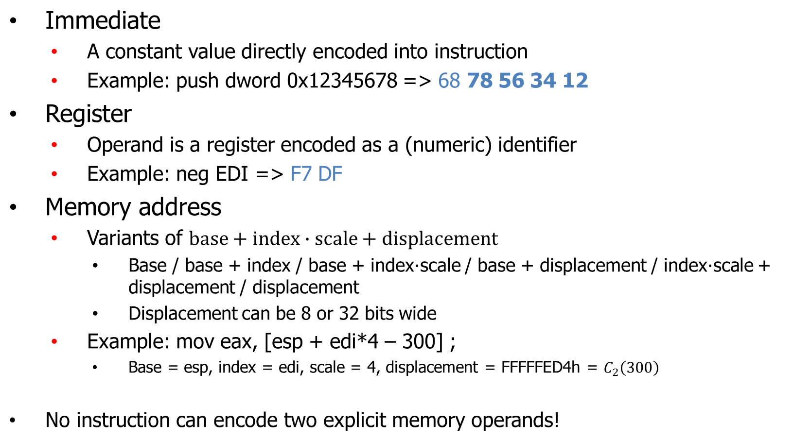
Addressing modes

Slide 27
5. Instruction set overview

Slide 28
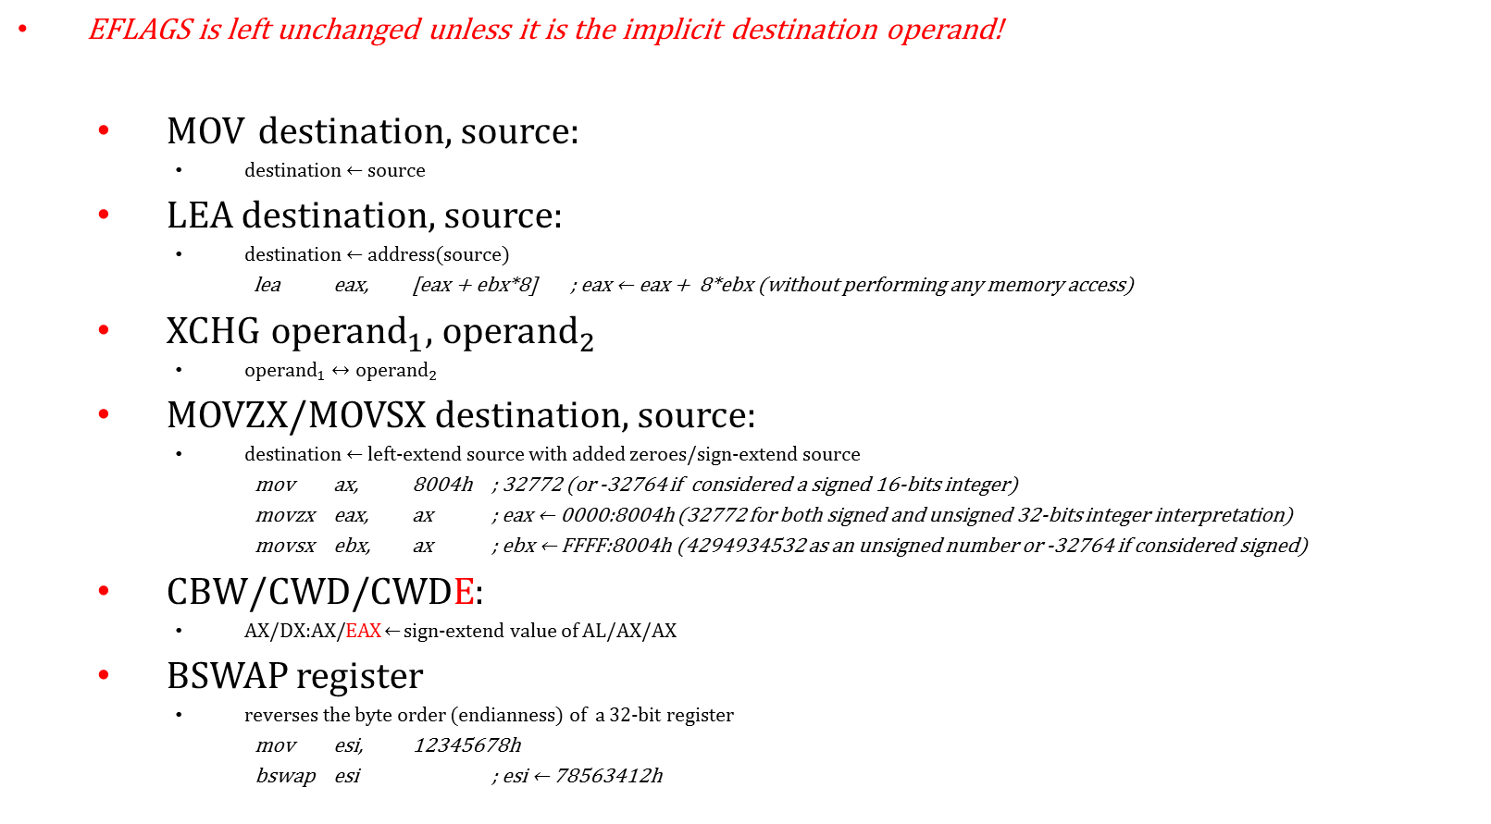
Data transfer and conversions

Slide 29
Data transfer and conversions
EFLAGS is left unchanged unless it is the implicit destination operand!
  PUSH source
    ESP ← ESP – size(source)
    SS:[ESP] ← source
  POP destination
    Destination ← SS:[ESP]
    ESP ← ESP + size(destination)
  PUSHA
    PUSH current values of registers in this order: EAX, ECX, EDX, EBX, ESP, EBP, ESI, EDI
  POPA
    POP values in registers in this order: EDI, ESI, EBP, ESP, EBX, EDX, ECX, EAX
  PUSHF/PUSHFD
  POPF/POPFD
    Modifies EFLAGS!

Slide 30
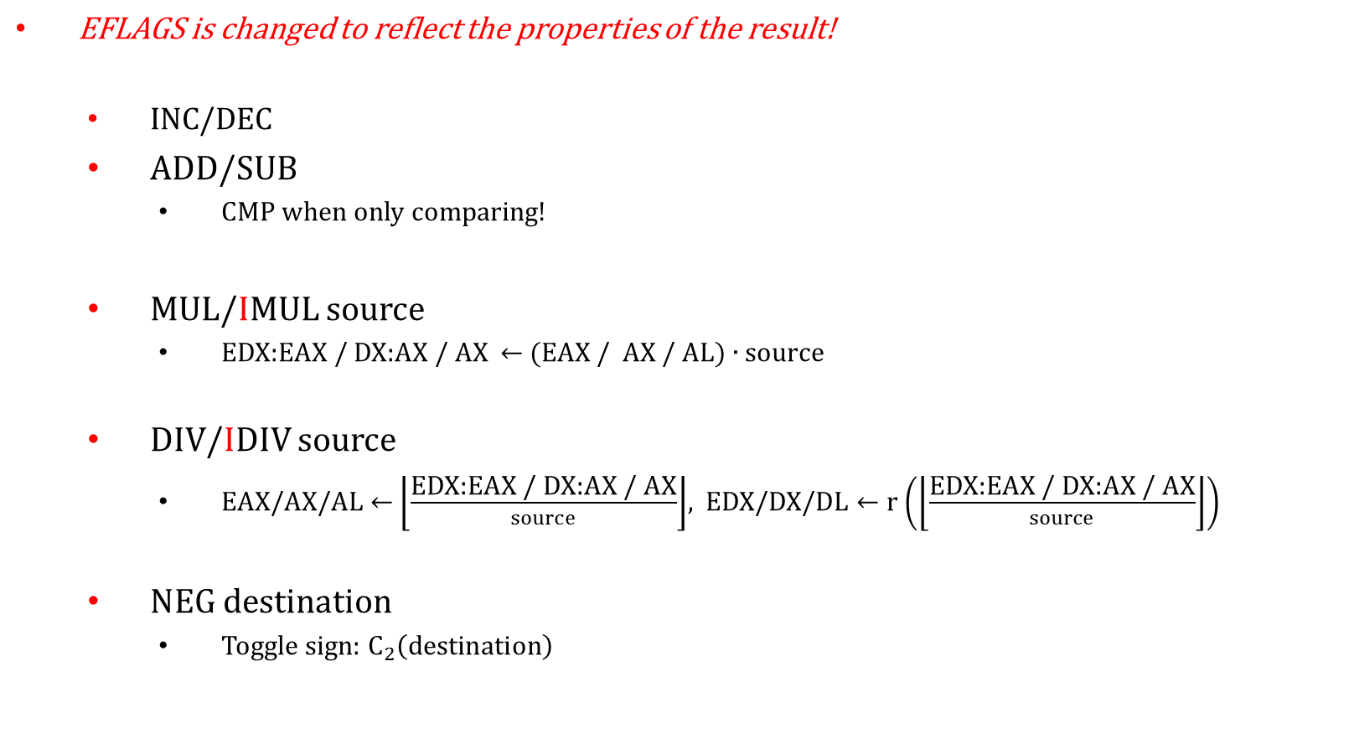
Arithmetic instructions

Slide 31
Logic Instructions
EFLAGS is changed to reflect the properties of the result!
  AND destination, source
    Clear unwanted bits or check for present bits
    TEST when only checking!
  OR destination, source
    Set needed bits
  XOR destination, source
    Toggle targeted bits
  NOT destination
    Invert bit values

Slide 32
Bit manipulation instructions
EFLAGS is changed to reflect the properties of the result!
  SHL/SAL destination, count
    Shifts the bits of destination count positions to the left
    repeated multiplication by 2
  SHR/SAR destination, count
    Shifts the bits of destination count positions to the right
    repeated division by 2 (SAR preserves the sign)
  ROL/RCL destination, count
    Rotate destination by count positions to the left
    RCL considers CF as an additional leftmost bit of destination
  ROR/RCR destination, count
    Rotate destination by count positions to the right
    RCR considers CF as an additional rightmost bit of destination

Slide 33
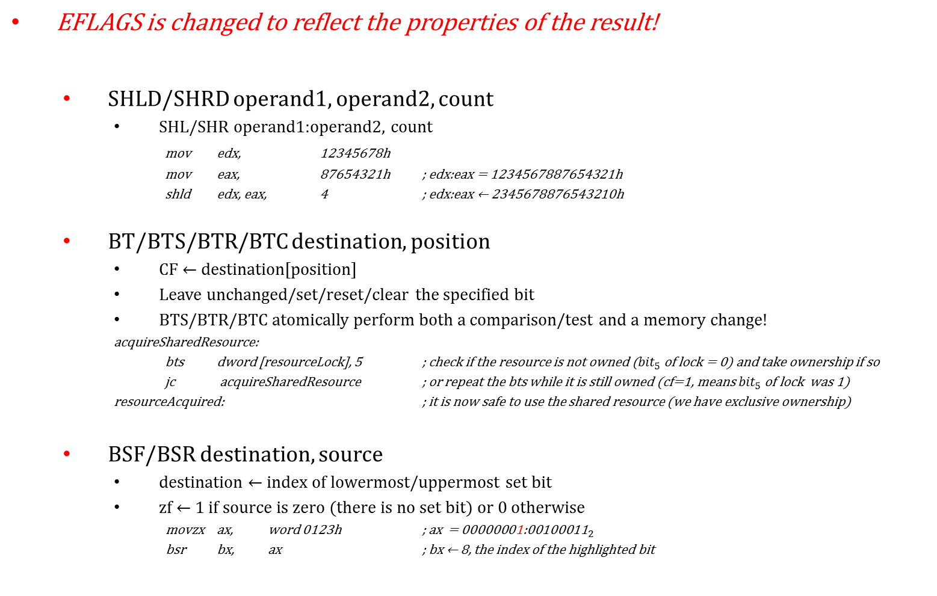
Bit manipulation instructions

Slide 34
Control flow instructions
  JMP address
  CALL address
  RET
  INT vector_number
  IRET
  J(c/nc/z/nz/p/np/s/ns/o/no) address
    Jump if specified flag is/isn’t set
  J(l/le/g/ge/nl/nle/ng/nge) address
    Jump if at CMP or SUB the first operand was not less/greater or equal to the second, SIGNED
  J(b/be/a/ae/nb/nbe/na/nae) address
    Jump if at CMP or SUB the first operand was not below/above or equal to the second

Slide 35
Control flow instructions
  LOOP/LOOPZ/LOOPNZ address
    Precondition: nothing/check ZF=1/check ZF=0
    Decrement ECX then jump to address if the updated CX value is not zero
    What if ECX = 0 ?
    Don’t only initialize the CX part of ECX when executing a loop!
  JCXZ/JECXZ address

Slide 36
System Instructions
These instructions are reserved for OS usage and boot-loaders or other privileged applications!
  LIDT/LGDT/SIDT/SGDT/LTR/STR
    Tell the CPU where the global descriptor table or other such data structures are located
  IN/OUT/INS*/OUTS*
    Talk to an external device
  RDMSR/WRMSR
    Read or modify special registers (current CPU temperature, performance statistics, etc…)
  HLT
    Stop execution, used after signaling a critical hardware or software fault
  VMXON/VMCALL/VMRESUME/…
    Hardware (CPU-based) Virtualization support
  …

Slide 37
System Instructions
[bits 16]
Code:
cli ; stop receiving any (maskable) interrupts
lgdt [Gdt] ; make the descriptor table known to the CPU
mov eax, cr0 ; take old value of CR0
or eax, 1 ; change only one bit
mov cr0, eax ; activate ProtectionEnble in CR0
jmp DescriptorTable.code16 - DescriptorTable : ProtectedMode
ProtectedMode:
mov ax, 16 ; data selector: segment descriptor (position/selector 16)
mov ds, ax ; set the new data segment
jmp 32 : ProtectedMode32 ; set new code segment (position/selector 32)
[bits 32]
ProtectedMode32:
hlt ; stop execution
; data
DescriptorTable: ...
Gdt: ...

Slide 38
6. Controlling execution flow

Slide 39
Controlling execution flow
Unconditional call or jump instructions
Loop instruction
Combination of
  instruction affecting EFLAGS
  Conditional jump

Slide 40
Controlling execution flow
Example
  mov eax, 0
  mov ecx, 10
  retry:
  dec eax
  cmp eax, 0 ; is the cmp necessary?
  jb firstConditionWasTrue ; will it take this jump?
  jl secondConditionWasTrue ; how about this one?
  loop retry ; how many times does it repeat?
  jmp neither ; do we get here?
  firstConditionWasTrue: jmp done
  secondConditionWasTrue: jmp done
  neither:
  done:
  call tellTheWorld

Slide 41

7. Assembly language

Slide 42
Assembly language
There are many assembler implementations and related tools out there!
  MASM/ML
  NASM
  YASM
  TASM
  …
Dissasemblers
  IDA (there’s a free version available)
  OllyDbg,
  WinDbg
  NASM
  …

Slide 43
Assembly language
Syntax examples:
  MASM (case insensitive)
    push byte ptr foo
    mov bl, foo
    mov ax, ss:[ecx + 2*ebx – 5]
  NASM (case sensitive for identifiers)
  push byte [foo]
  mov bl, [foo]
  mov ax, ss:[ecx + 2*ebx – 5]
  AT&T (case sensitive, insensitive for identifiers)
    addl $4, %eax
    movb foo, %al
    movw %ss:5(%ecx,%ebx,2), %ax

Slide 44
Assembly language
Super-powers:
  Control over the memory layout of a program
  Control over the external dependencies
  Control over call conventions and function/procedure templates
  Access all and any types of system resources
  squeeze the last clock cycle or memory byte
  Mix 16/32/64 bit code
Usual limitations:
  No (runtime) expression evaluation support
  No runtime compiler checks (stability&security checks)
  No compiler optimizations, your code might be slower than an equivalent high-level compiled code
  Needs more time and attention => costly and error prone
  Not portable

Slide 45
32-bit Calling Conventions
Why? For interfacing with external libraries, both for calling and being called by code written in higher-level languages
  How many parameters? Any number?
  Where are they?
  How’s the result returned?
  Who performs any necessary cleanup?
Name | Storage | Order | Cleanup | Variable parameter count | Result
cdecl (C) | stack | ← | caller | √ | EAX
pascal | stack | → | callee |  | EAX
stdcall (MS) | stack | ← | callee |  | EAX
fastcall (MS) | ECX, EDX, stack | →, ← | callee |  | EAX
…

Slide 46
32-bit Calling Conventions
cdecl function call example (NASM):
;;; calling printf(“eax = %d\n”, eax)
  push eax ; we want to print the current value of eax
  push dword FmtStrPtr ; FmtStrPtr is the address of our format string
  call dword [printf] ; an imported function is seen as a variable whose value is a pointer to the external function (printf here)
  add esp, 2*4 ; cleanup: remove two DWORD values from the stack
  …
  FmtStrPtr db “eax = %d\n”, 0
stdcall function call example (NASM):
;;; calling ExitProcess(-1)
  push dword -1 ; exit code for our application
  call dword[ExitProcess]
  ; no cleanup necessary (even if ExitProcess would actually return)

Slide 47
Functions
stdcall function definition example (NASM):
addNumbers: ; adds two numeric paramters
push ebp ; save old ebp value
mov ebp, esp ; at ebp: old ebp, return address, params,…
mov eax, [ebp + 2*4]; skip old ebp and the retaddr
add eax, [ebp + 3*4]; also skip the first operand
pop ebp ; restore ebp
ret 2*4 ; free the 2 parameters and return (eax=result)

Slide 48
Functions
cdecl function definition example (NASM):
addNumbers: ; arguments: Count, Number[0], Number[1], … Number[Count-1]
push ebp ; save/preserve old ebp value
mov ebp, esp ; at ebp: old ebp, ret address, Count, …
lea esi, [ebp + 2*4] ; esi = ebp + 8 = address of Count
mov ecx, [esi] ; ecx = value of Count
add esi, 4 ; advance esi to the next parameter
xor ebx, ebx ; ebx = 0
.next:
loadsd ; eax = [esi], esi = esi + 4
add ebx, eax
loop .next ; do this for all numbers
mov eax, ebx ; prepare return value in eax
pop ebp ; restore ebp
ret ; return without freeing the arguments

Slide 49
Single-Line macros(NASM)
Numeric (compile-time) constants
    PAGE_SIZE equ 4096
    …
    cmp ecx, PAGE_SIZE
    ja .bufferOverflow
Textual replacement single-line macros
    %define MAX(X,Y) ((X) > (Y) ? (X) : (Y))
    …
    mov eax, MAX(0x4000, PAGE_SIZE)

Slide 50
Multi-Line macros(NASM)
Powerful textual replacement (like a programmatic search&replace)
Allows you to implement missing abstractions like:
  Defining and calling functions
  Adding debugging code facilities
  Extending the instruction set
  Implement structured code support (statements like if, while, repeat,…)
  %macro MOV_MM 2 ; 2 parameters, implements mov mem, mem
  push dword %2 ; save second (source) parameter on stack
  pop dword %1 ; restore the data inside the destination
  %endmacro
  …
  MOV_MM [ebp + 12], [esi + ecx*8 + 2]

Slide 51
Multi-Line macros (NASM)
  %macro CDECL_CALL 1-* ; any parameter count (at least one)
  ; push all function parameters on stack
  %rep %0-1 ; %0 = number of params, skip function
  %rotate -1 ; rotate params to left -1 positions
  push dword %1 ; save the parameter on stack
  %endrep
  %rotate -1 ; back to original arguments order
  call %1 ; actual function call
  add esp, 4*(%0-1) ; free the used stack space
  %endmacro
  …
  CDECL_CALL printf, FmtStrPtr, ecx

